Slide 1
Learn HTML 5

Slide 2
HTML5 Introduction
The DOCTYPE declaration for HTML5 is very simple:
<!DOCTYPE html>
The character encoding (charset) declaration is also very simple:
<meta charset="UTF-8">
<!DOCTYPE html>
<html>
<head>
<meta charset="UTF-8">
<title>Title of the document</title>
</head>
<body>
Content of the document......
</body>
</html>

Slide 3
New HTML5 Elements
The most interesting new HTML5 elements are:
New semantic elements like <header>, <footer>, <article>, and <section>.
New attributes of form elements like number, date, time, calendar, and range.
New graphic elements: <svg> and <canvas>.
New multimedia elements: <audio> and <video>.
New HTML5 API's (Application Programming Interfaces)
The most interesting new API's in HTML5 are:
HTML Geolocation
HTML Drag and Drop
HTML Local Storage
HTML Application Cache
HTML Web Workers
HTML SSE

Slide 4
HTML History
Year | Version
1989 | Tim Berners-Lee invented www
1991 | Tim Berners-Lee invented HTML
1993 | Dave Raggett drafted HTML+
1995 | HTML Working Group defined HTML 2.0
1997 | W3C Recommendation: HTML 3.2
1999 | W3C Recommendation: HTML 4.01
2000 | W3C Recommendation: XHTML 1.0
2008 | WHATWG HTML5 First Public Draft
2012 | WHATWG HTML5 Living Standard
2014 | W3C Recommendation: HTML5
2016 | W3C Candidate Recommendation: HTML 5.1

Slide 5
New Semantic/Structural Elements
Tag | Description
<article> | Defines an article in the document
<aside> | Defines content aside from the page content
<bdi> | Defines a part of text that might be formatted in a different direction from other text
<details> | Defines additional details that the user can view or hide
<dialog> | Defines a dialog box or window
<figcaption> | Defines a caption for a <figure> element
<figure> | Defines self-contained content, like illustrations, diagrams, photos, code listings, etc.
<footer> | Defines a footer for the document or a section
<header> | Defines a header for the document or a section
<main> | Defines the main content of a document
<mark> | Defines marked or highlighted text
<menuitem> | Defines a command/menu item that the user can invoke from a popup menu
<meter> | Defines a scalar measurement within a known range (a gauge)
<nav> | Defines navigation links in the document
<progress> | Defines the progress of a task
<rp> | Defines what to show in browsers that do not support ruby annotations
<rt> | Defines an explanation/pronunciation of characters (for East Asian typography)
<ruby> | Defines a ruby annotation (for East Asian typography)
<section> | Defines a section in the document
<summary> | Defines a visible heading for a <details> element
<time> | Defines a date/time
<wbr> | Defines a possible line-break

Slide 6
New Form Elements
Tag | Description
<datalist> | Defines pre-defined options for input controls. The <datalist> tag is used to provide an "autocomplete" feature on <input> elements. Users will see a drop-down list of pre-defined options as they input data.
<keygen> | Defines a key-pair generator field (for forms). When the form is submitted, the private key is stored locally, and the public key is sent to the server.
<output> | Defines the result of a calculation <form oninput="x.value=parseInt(a.value)+parseInt(b.value)">0 <input type="range" id="a" value="50">100 +<input type="number" id="b" value="50"> =<output name="x" for="a b"></output> </form>

Slide 7
New Input Types
New Input Types | New Input Attributes
color date datetime datetime-local email month number range search tel time url Week | autocomplete autofocus form formaction formenctype formmethod formnovalidate formtarget height and width list min and max multiple pattern (regexp) placeholder required step

Slide 8
Attribute | Value | Description
accept | file_extension audio/* video/* image/* media_type | Specifies the types of files that the server accepts (only for type="file")
align | Left , right , top ,middle bottom | Not supported in HTML5. Specifies the alignment of an image input (only for type="image")
alt | Text | Specifies an alternate text for images (only for type="image")
autocomplete | on off | Specifies whether an <input> element should have autocomplete enabled
autofocus | Autofocus | Specifies that an <input> element should automatically get focus when the page loads
checked | Checked | Specifies that an <input> element should be pre-selected when the page loads (for type="checkbox" or type="radio")
dirname | inputname.dir | Specifies that the text direction will be submitted
disabled | Disabled | Specifies that an <input> element should be disabled
form | form_id | Specifies one or more forms the <input> element belongs to
formaction | URL | Specifies the URL of the file that will process the input control when the form is submitted (for type="submit" and type="image")
Formenctype | application/x-www-form-urlencoded multipart/form-data text/plain | Specifies how the form-data should be encoded when submitting it to the server (for type="submit" and type="image")
Formmethod | get post | Defines the HTTP method for sending data to the action URL (for type="submit" and type="image")
Value | Text | Specifies the value of an <input> element
Width | Pixels | Specifies the width of an <input> element (only for type="image")

Slide 9
Formnovalidate | Formnovalidate | Defines that form elements should not be validated when submitted
Formtarget | _blank _self _parent _top framename | Specifies where to display the response that is received after submitting the form (for type="submit" and type="image")
Height | Pixels | Specifies the height of an <input> element (only for type="image")
List | datalist_id | Refers to a <datalist> element that contains pre-defined options for an <input> element
Max | number date | Specifies the maximum value for an <input> element
Maxlength | Number | Specifies the maximum number of characters allowed in an <input> element
Min | number date | Specifies a minimum value for an <input> element
Multiple | Multiple | Specifies that a user can enter more than one value in an <input> element
Name | Text | Specifies the name of an <input> element
Pattern | Regexp | Specifies a regular expression that an <input> element's value is checked against
Placeholder | Text | Specifies a short hint that describes the expected value of an <input> element
Readonly | Readonly | Specifies that an input field is read-only
Required | Required | Specifies that an input field must be filled out before submitting the form
Size | Number | Specifies the width, in characters, of an <input> element
Src | URL | Specifies the URL of the image to use as a submit button (only for type="image")
Step | Number | Specifies the legal number intervals for an input field
Type |  | Specifies the type <input> element to display button,checkbox,color,date ,datetime ,datetime-local ,email ,file,hidden,image,month ,number ,password,radio,range ,reset,search,submit,tel,text,time ,url,week

Slide 10
HTML5 - New Attribute Syntax
Type | Example
Empty | <input type="text" value="John" disabled>
Unquoted | <input type="text" value=John>
Double-quoted | <input type="text" value="John Doe">
Single-quoted | <input type="text" value='John Doe'>

Slide 11
HTML5 Graphics
Tag | Description
<canvas> | Draw graphics, on the fly, via scripting (usually JavaScript)
<svg> | Draw scalable vector graphics

Slide 12
New Media Elements
Tag | Description
<audio> | Defines sound content
<embed> | Defines containers for external applications (like plug-ins)
<source> | Defines sources for <video> and <audio>
<track> | Defines tracks for <video> and <audio>
<video> | Defines video or movie content

Slide 13
HTML5 Semantic Elements
What are Semantic Elements?
A semantic element clearly describes its meaning to both the browser and the developer.
Examples of non-semantic elements: <div> and <span> - Tells nothing about its content.
Examples of semantic elements: <form>, <table>, and <article> - Clearly defines its content.

Slide 14
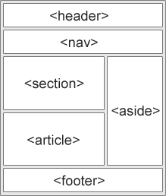
New Semantic Elements in HTML5
<article> | <footer>
<aside> | <header>
<details> | <main>
<figcaption> | <mark>
<figure> | <nav>
<section> | <summary>
<time>
Many web sites contain HTML code like: <div id="nav"> <div class="header">
<div id="footer"> to indicate navigation, header, and footer.
HTML5 offers new semantic elements to define different parts of a web page:

Slide 15
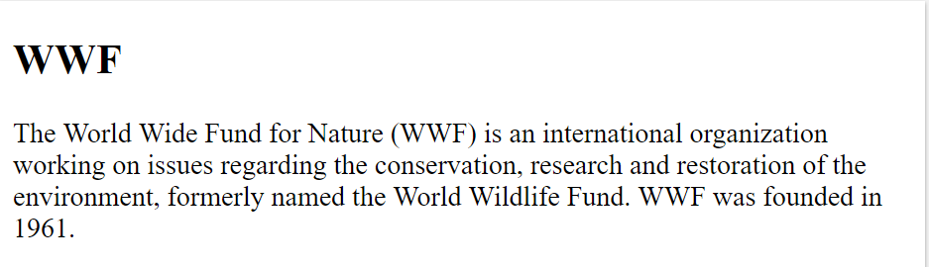
HTML5 <section> Element
The <section> element defines a section in a document.
According to W3C's HTML5 documentation: "A section is a thematic grouping of content, typically with a heading."
A home page could normally be split into sections for introduction, content, and contact information.
<section>
<h1>WWF</h1>
<p>The World Wide Fund for Nature (WWF) is an international organization working on issues regarding the conservation, research and restoration of the environment, formerly named the World Wildlife Fund. WWF was founded in 1961.</p>
</section>

Slide 16
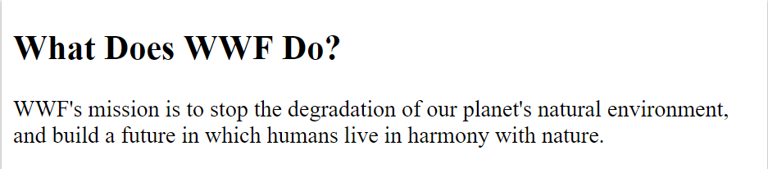
HTML5 <article> Element
The <article> element specifies independent, self-contained content.
An article should make sense on its own, and it should be possible to read it independently from the rest of the web site.
Examples of where an <article> element can be used:
Forum post
Blog post
Newspaper article
<article>
<h1>What Does WWF Do?</h1>
<p>WWF's mission is to stop the degradation of our planet's natural environment, and build a future in which humans live in harmony with nature.</p>
</article>

Slide 17
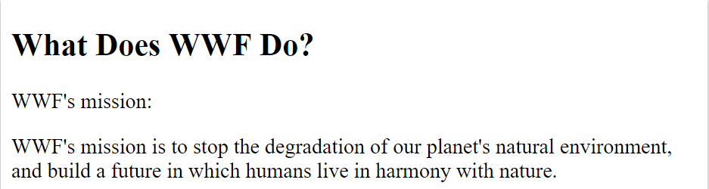
HTML5 <header> Element
The <header> element specifies a header for a document or section.
The <header> element should be used as a container for introductory content.
You can have several <header> elements in one document.
The following example defines a header for an article:
<article>
<header>
<h1>What Does WWF Do?</h1>
<p>WWF's mission:</p>
</header>
<p>WWF's mission is to stop the degradation of our planet's natural environment, and build a future in which humans live in harmony with nature.</p>
</article>

Slide 18
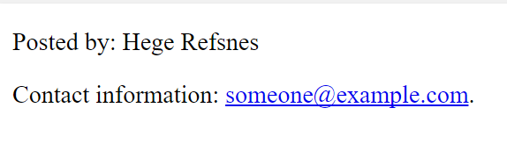
HTML5 <footer> Element
The <footer> element specifies a footer for a document or section.
A <footer> element should contain information about its containing element.
A footer typically contains the author of the document, copyright information, links to terms of use, contact information, etc.
You may have several <footer> elements in one document.
<footer>
<p>Posted by: Hege Refsnes</p>
<p>Contact information: <a href="mailto:someone@example.com">
someone@example.com</a>.</p>
</footer>

Slide 19

HTML5 <nav> Element
The <nav> element defines a set of navigation links.
Notice that NOT all links of a document should be inside a <nav> element. The <nav> element is intended only for major block of navigation links.
<nav>
<a href="/html/">HTML</a> |
<a href="/css/">CSS</a> |
<a href="/js/">JavaScript</a> |
<a href="/jquery/">jQuery</a>
</nav>

Slide 20
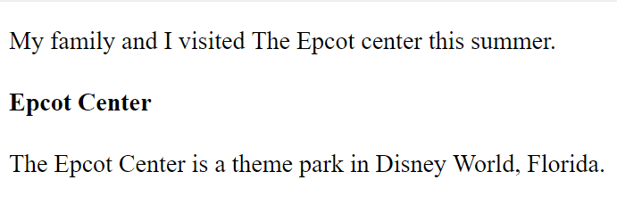
HTML5 <aside> Element
The <aside> element defines some content aside from the content it is placed in (like a sidebar).
The aside content should be related to the surrounding content.
<p>My family and I visited The Epcot center this summer.</p>
<aside>
<h4>Epcot Center</h4>
<p>The Epcot Center is a theme park in Disney World, Florida.</p>
</aside>

Slide 21
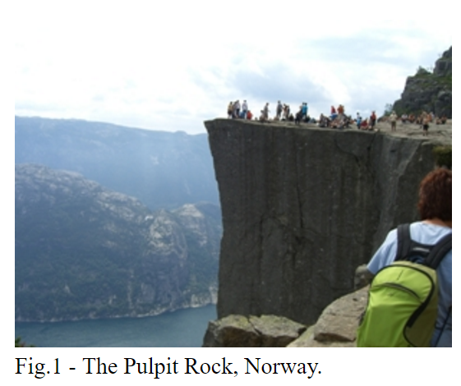
HTML5 <figure> and <figcaption> Elements
The purpose of a figure caption is to add a visual explanation to an image.
In HTML5, an images and a caption can be grouped together in a <figure> element:
<figure>
<img src="pic_mountain.jpg" alt="The Pulpit Rock" width="304"height="228">
<figcaption>Fig1. - The Pulpit Rock, Norway.</figcaption>
</figure>

Slide 22
Tag | Description
<article> | Defines an article
<aside> | Defines content aside from the page content
<details> | Defines additional details that the user can view or hide
<figcaption> | Defines a caption for a <figure> element
<figure> | Specifies self-contained content, like illustrations, diagrams, photos, code listings, etc.
<footer> | Defines a footer for a document or section
<header> | Specifies a header for a document or section
<main> | Specifies the main content of a document
<mark> | Defines marked/highlighted text
<nav> | Defines navigation links
<section> | Defines a section in a document
<summary> | Defines a visible heading for a <details> element
<time> | Defines a date/time

Slide 23

HTML5 Canvas
What is HTML Canvas?
The HTML <canvas> element is used to draw graphics, on the fly, via JavaScript.
The <canvas> element is only a container for graphics. You must use a JavaScript to actually draw the graphics.
Canvas has several methods for drawing paths, boxes, circles, text, and adding images.
Canvas Examples
A canvas is a rectangular area on an HTML page. By default, a canvas has no border and no content.
The markup looks like this:
<canvas id="myCanvas" width="200" height="100"></canvas>

Slide 24
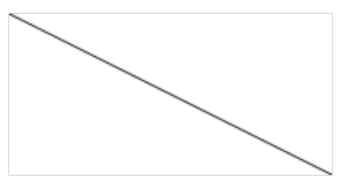
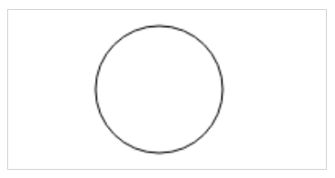
Draw a Line
<script>
var c = document.getElementById("myCanvas");
var ctx = c.getContext("2d");
ctx.moveTo(0,0);
ctx.lineTo(200,100);
ctx.stroke();
</script>
Draw a Circle
<script>
var c = document.getElementById("myCanvas");
var ctx = c.getContext("2d");
ctx.beginPath();
ctx.arc(95,50,40,0,2*Math.PI);
ctx.stroke();
</script>

Slide 25


Draw a Text
<script>
var c = document.getElementById("myCanvas");
var ctx = c.getContext("2d");
ctx.font = "30px Arial";
ctx.fillText("Hello World",10,50);
</script>
Stroke Text
<script>
var c = document.getElementById("myCanvas");
var ctx = c.getContext("2d");
ctx.font = "30px Arial";
ctx.strokeText("Hello World",10,50);
</script>

Slide 26
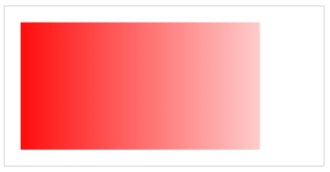
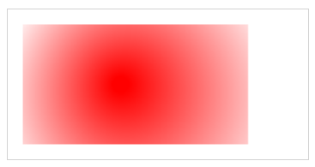
Draw Linear Gradient
<script>
var c = document.getElementById("myCanvas");
var ctx = c.getContext("2d");
// Create gradient
var grd = ctx.createLinearGradient(0,0,200,0);
grd.addColorStop(0,"red");
grd.addColorStop(1,"white");
// Fill with gradient
ctx.fillStyle = grd;
ctx.fillRect(10,10,150,80);
</script>
Draw Circular Gradient
<script>
var c = document.getElementById("myCanvas");
var ctx = c.getContext("2d");
// Create gradient
var grd = ctx.createRadialGradient(75,50,5,90,60,100);
grd.addColorStop(0,"red");
grd.addColorStop(1,"white");
// Fill with gradient
ctx.fillStyle = grd;
ctx.fillRect(10,10,150,80);
</script>

Slide 27
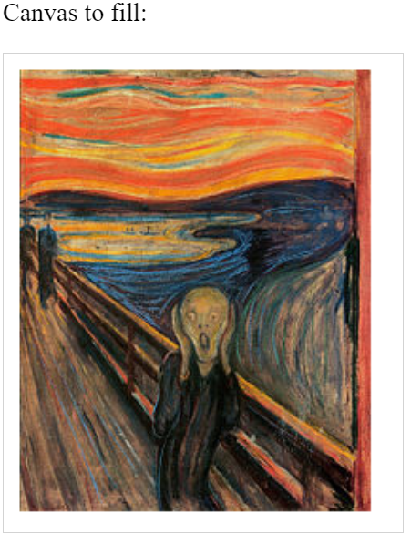
Draw Image
<script>
function myCanvas() {
var c = document.getElementById("myCanvas");
var ctx = c.getContext("2d");
var img = document.getElementById("scream");
ctx.drawImage(img,10,10);
}
</script>

Slide 28
HTML5 SVG
What is SVG?
SVG stands for Scalable Vector Graphics
SVG is used to define graphics for the Web
SVG is a W3C recommendation
The HTML <svg> Element
The HTML <svg> element is a container for SVG graphics.
SVG has several methods for drawing paths, boxes, circles, text, and graphic images.

Slide 29

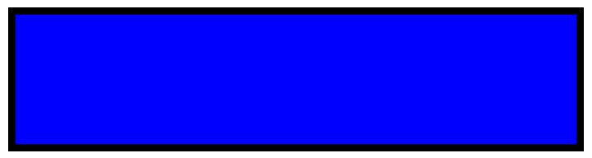
SVG Circle
<!DOCTYPE html>
<html>
<body>
<svg width="100" height="100">
<circle cx="50" cy="50" r="40" stroke="green" stroke-width="4"fill="yellow" />
</svg>
</body>
</html>
SVG Rectangle
<html>
<body>
<svg width="400" height="100">
<rect width="400" height="100"
style="fill:rgb(0,0,255);stroke-width:10;stroke:rgb(0,0,0)" />
</svg>
</body>
</html>

Slide 30


SVG Rounded Rectangle
<html>
<body>
<svg width="400" height="180">
<rect x="50" y="20" rx="20" ry="20" width="150" height="150"
style="fill:red;stroke:black;stroke-width:5;opacity:0.5" />
</svg>
</body>
</html>
SVG Star
<html>
<body>
<svg width="300" height="200">
<polygon points="100,10 40,198 190,78 10,78 160,198"
style="fill:lime;stroke:purple;stroke-width:5;fill-rule:evenodd;" />
</svg>
</body>
</html>

Slide 31

SVG Logo
<svg height="130" width="500">
<defs>
<linearGradient id="grad1" x1="0%" y1="0%" x2="100%" y2="0%">
<stop offset="0%" style="stop-color:rgb(255,255,0);stop-opacity:1" />
<stop offset="100%" style="stop-color:rgb(255,0,0);stop-opacity:1" />
</linearGradient>
</defs>
<ellipse cx="100" cy="70" rx="85" ry="55" fill="url(#grad1)" />
<text fill="#ffffff" font-size="45" font-family="Verdana" x="50"y="86">SVG</text>
Sorry, your browser does not support inline SVG.
</svg>

Slide 32
Differences Between SVG and Canvas
SVG is a language for describing 2D graphics in XML.
Canvas draws 2D graphics, on the fly (with a JavaScript).
SVG is XML based, which means that every element is available within the SVG DOM. You can attach JavaScript event handlers for an element.
In SVG, each drawn shape is remembered as an object. If attributes of an SVG object are changed, the browser can automatically re-render the shape.
Canvas is rendered pixel by pixel. In canvas, once the graphic is drawn, it is forgotten by the browser. If its position should be changed, the entire scene needs to be redrawn, including any objects that might have been covered by the graphic.

Slide 33
Comparison of Canvas and SVG
Canvas | SVG
Resolution dependent No support for event handlers Poor text rendering capabilities You can save the resulting image as .png or .jpg Well suited for graphic-intensive games | Resolution independent Support for event handlers Best suited for applications with large rendering areas (Google Maps) Slow rendering if complex (anything that uses the DOM a lot will be slow) Not suited for game applications

Slide 34
HTML Multimedia
What is Multimedia?
Multimedia comes in many different formats. It can be almost anything you can hear or see.
Examples: Images, music, sound, videos, records, films, animations, and more.
Web pages often contain multimedia elements of different types and formats.
In this chapter you will learn about the different multimedia formats.

Slide 35
Multimedia Formats
Multimedia elements (like audio or video) are stored in media files.
The most common way to discover the type of a file, is to look at the file extension.
Multimedia files have formats and different extensions like: .swf, .wav, .mp3, .mp4, .mpg, .wmv, and .avi.
Note: Only MP3, WAV, and Ogg audio are supported by the HTML5 standard.

Slide 36
Format | File | Description
MPEG | .mpg .mpeg | MPEG. Developed by the Moving Pictures Expert Group. The first popular video format on the web. Used to be supported by all browsers, but it is not supported in HTML5 (See MP4).
AVI | .avi | AVI (Audio Video Interleave). Developed by Microsoft. Commonly used in video cameras and TV hardware. Plays well on Windows computers, but not in web browsers.
WMV | .wmv | WMV (Windows Media Video). Developed by Microsoft. Commonly used in video cameras and TV hardware. Plays well on Windows computers, but not in web browsers.
QuickTime | .mov | QuickTime. Developed by Apple. Commonly used in video cameras and TV hardware. Plays well on Apple computers, but not in web browsers. (See MP4)
RealVideo | .rm .ram | RealVideo. Developed by Real Media to allow video streaming with low bandwidths. It is still used for online video and Internet TV, but does not play in web browsers.
Flash | .swf .flv | Flash. Developed by Macromedia. Often requires an extra component (plug-in) to play in web browsers.
Ogg | .ogg | Theora Ogg. Developed by the Xiph.Org Foundation. Supported by HTML5.
WebM | .webm | WebM. Developed by the web giants, Mozilla, Opera, Adobe, and Google. Supported by HTML5.
MPEG-4 or MP4 | .mp4 | MP4. Developed by the Moving Pictures Expert Group. Based on QuickTime. Commonly used in newer video cameras and TV hardware. Supported by all HTML5 browsers. Recommended by YouTube.

Slide 37
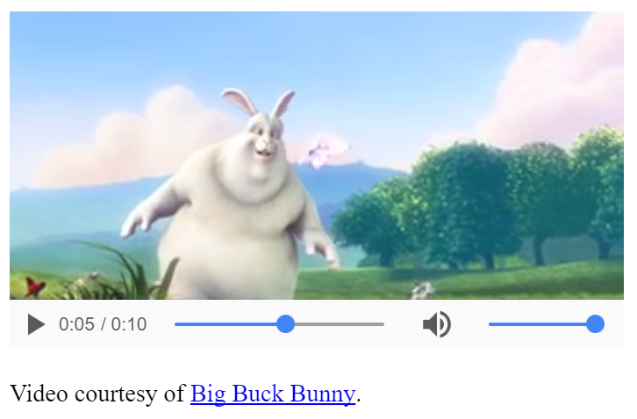
HTML5 Video
<body>
<video width="400" controls>
<source src="mov_bbb.mp4" type="video/mp4">
<source src="mov_bbb.ogg" type="video/ogg">
Your browser does not support HTML5 video.
</video>
<p>
Video courtesy of
<a href="http://www.bigbuckbunny.org/" target="_blank">Big Buck Bunny</a>.
</p>

Slide 38
How it Works
The controls attribute adds video controls, like play, pause, and volume.
It is a good idea to always include width and height attributes. If height and width are not set, the page might flicker while the video loads.
The <source> element allows you to specify alternative video files which the browser may choose from. The browser will use the first recognized format.
The text between the <video> and </video> tags will only be displayed in browsers that do not support the <video> element

Slide 39
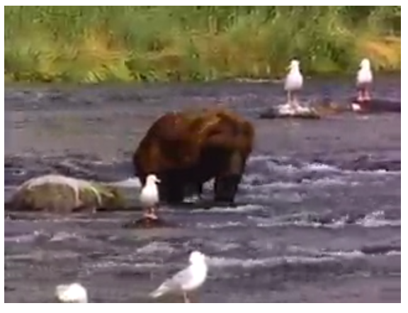
HTML <video> Autoplay
<video width="320" height="240" autoplay>
<source src="movie.mp4" type="video/mp4">
<source src="movie.ogg" type="video/ogg">
Your browser does not support the video tag.
</video>

Slide 40
HTML Video - Browser Support
Browser | MP4 | WebM | Ogg
Internet Explorer | YES | NO | NO
Chrome | YES | YES | YES
Firefox | YES | YES | YES
Safari | YES | NO | NO
Opera | YES (from Opera 25) | YES | YES

Slide 41
<div style="text-align:center">
<button onclick="playPause()">Play/Pause</button>
<button onclick="makeBig()">Big</button>
<button onclick="makeSmall()">Small</button>
<button onclick="makeNormal()">Normal</button>
<br><br>
<video id="video1" width="420">
<source src="mov_bbb.mp4" type="video/mp4">
<source src="mov_bbb.ogg" type="video/ogg">
Your browser does not support HTML5 video.
</video>
</div>
<script>
var myVideo = document.getElementById("video1");
function playPause() {
if (myVideo.paused)
myVideo.play();
else
myVideo.pause(); }
function makeBig() { myVideo.width = 560; }
function makeSmall() { myVideo.width = 320; }
function makeNormal() { myVideo.width = 420; }
</script>

Slide 42
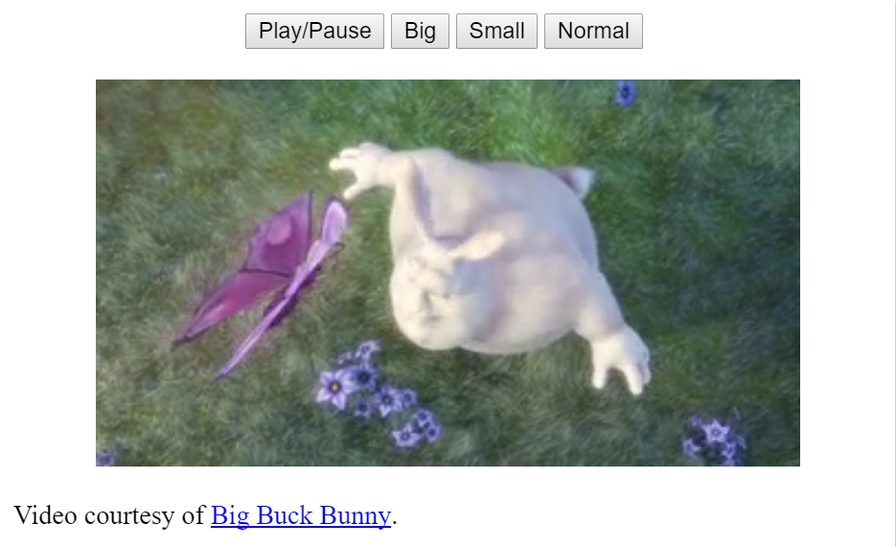

Slide 43
HTML5 Video Tags
<video> | Defines a video or movie
<source> | Defines multiple media resources for media elements, such as <video> and <audio>
<track> | Defines text tracks in media players

Slide 44
HTML5 Audio
Audio on the Web
Before HTML5, audio files could only be played in a browser with a plug-in (like flash).
The HTML5 <audio> element specifies a standard way to embed audio in a web page.

Slide 45

The HTML <audio> Element
<audio controls>
<source src="horse.ogg" type="audio/ogg">
<source src="horse.mp3" type="audio/mpeg">
Your browser does not support the audio element.
</audio>

Slide 46
HTML Audio - How It Works
The controls attribute adds audio controls, like play, pause, and volume.
The <source> element allows you to specify alternative audio files which the browser may choose from. The browser will use the first recognized format.
The text between the <audio> and </audio> tags will only be displayed in browsers that do not support the <audio> element.

Slide 47
HTML Audio - Browser Support
Browser | MP3 | Wav | Ogg
Internet Explorer | YES | NO | NO
Chrome | YES | YES | YES
Firefox | YES | YES | YES
Safari | YES | YES | NO
Opera | YES | YES | YES

Slide 48
HTML Audio - Media Types
File Format | Media Type
MP3 | audio/mpeg
Ogg | audio/ogg
Wav | audio/wav
HTML5 Audio Tags
Tag | Description
<audio> | Defines sound content
<source> | Defines multiple media resources for media elements, such as <video> and <audio>

Slide 49
HTML Plug-ins
HTML Helpers (Plug-ins)
Helper applications (plug-ins) are computer programs that extend the standard functionality of a web browser.
Examples of well-known plug-ins are Java applets.
Plug-ins can be added to web pages with the <object> tag or the <embed> tag.
Plug-ins can be used for many purposes: display maps, scan for viruses, verify your bank id, etc.

Slide 50


The <object> Element
The <object> element is supported by all browsers.
The <object> element defines an embedded object within an HTML document.
It is used to embed plug-ins (like Java applets, PDF readers, Flash Players) in web pages
<object width="400" height="50" data="bookmark.swf"></object>
<object width="100%" height="500px" data="snippet.html"></object>
<object data="audi.jpeg"></object>

Slide 51
The <embed> Element
The <embed> element is supported in all major browsers.
The <embed> element also defines an embedded object within an HTML document.
Web browsers have supported the <embed> element for a long time. However, it has not been a part of the HTML specification before HTML5.
<embed width="400" height="50" src="bookmark.swf">
<embed width="100%" height="500px" src="snippet.html">
<embed src="audi.jpeg">

Slide 52
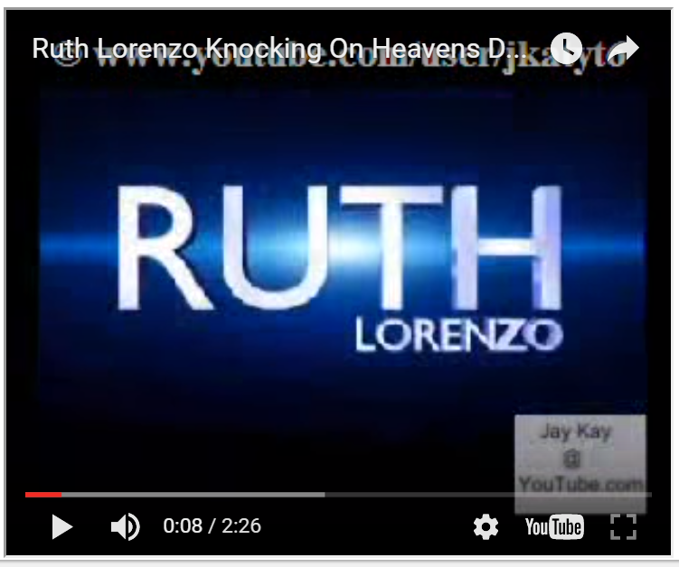
Playing a YouTube Video in HTML
To play your video on a web page, do the following:
Upload the video to YouTube
Take a note of the video id
Define an <iframe> element in your web page
Let the src attribute point to the video URL
Use the width and height attributes to specify the dimension of the player
Add any other parameters to the URL (see below)
<iframe width="420" height="345" src="https://www.youtube.com/embed/XGSy3_Czz8k">
</iframe>

Slide 53
YouTube Autoplay
You can have your video start playing automatically when a user visits that page by adding a simple parameter to your YouTube URL.
Value 0 (default): The video will not play automatically when the player loads.
Value 1: The video will play automatically when the player loads
<iframe width="420" height="345" src="https://www.youtube.com/embed/XGSy3_Czz8k?autoplay=1">
</iframe>
YouTube Loop
<iframe width="420" height="315"
src="https://www.youtube.com/embed/XGSy3_Czz8k?
playlist=XGSy3_Czz8k&loop=1">
</iframe>

Slide 54
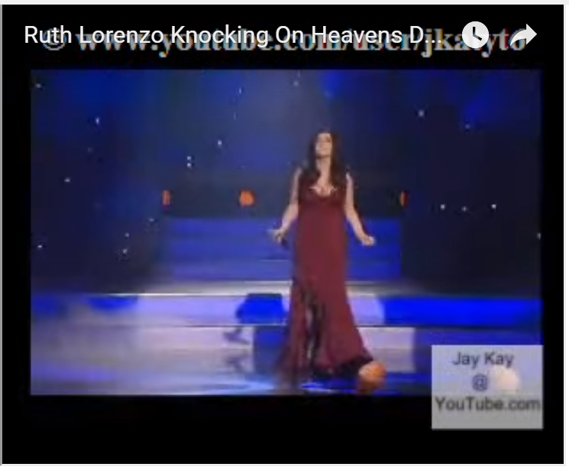
YouTube Controls
Value 0: Player controls does not display.
Value 1 (default): Player controls display.
<iframe width="420" height="315"
src="https://www.youtube.com/embed/XGSy3_Czz8k?
controls=0">
</iframe>
YouTube - Using <object> or <embed>
<object width="420" height="315"
data="http://www.youtube.com/embed/XGSy3_Czz8k">
</object>
<embed width="420" height="315"
src="http://www.youtube.com/embed/XGSy3_Czz8k">

Slide 55
HTML5 Geolocation
Locate the User's Position
The HTML Geolocation API is used to get the geographical position of a user.
Since this can compromise privacy, the position is not available unless the user approves it.

Slide 56
Using HTML Geolocation
<script>
var x = document.getElementById("demo");
function getLocation() {
if (navigator.geolocation) {
navigator.geolocation.getCurrentPosition(showPosition);
} else {
x.innerHTML = "Geolocation is not supported by this browser.";
} }
function showPosition(position) {
x.innerHTML = "Latitude: " + position.coords.latitude +
"<br>Longitude: " + position.coords.longitude; }
</script>
Example explained:
Check if Geolocation is supported
If supported, run the getCurrentPosition() method. If not, display a message to the user
If the getCurrentPosition() method is successful, it returns a coordinates object to the function specified in the parameter (showPosition)
The showPosition() function outputs the Latitude and Longitude
The example above is a very basic Geolocation script, with no error handling.

Slide 57
Displaying the Result in a Map
function showPosition(position) {
var latlon = position.coords.latitude + "," + position.coords.longitude;
var img_url = "http://maps.googleapis.com/maps/api/staticmap?center=
"+latlon+"&zoom=14&size=400x300&sensor=false";
document.getElementById("mapholder").innerHTML = "<img src='"+img_url+"'>";
}

Slide 58
The getCurrentPosition() Method - Return Data
Property | Returns
coords.latitude | The latitude as a decimal number (always returned)
coords.longitude | The longitude as a decimal number (always returned)
coords.accuracy | The accuracy of position (always returned)
coords.altitude | The altitude in meters above the mean sea level (returned if available)
coords.altitudeAccuracy | The altitude accuracy of position (returned if available)
coords.heading | The heading as degrees clockwise from North (returned if available)
coords.speed | The speed in meters per second (returned if available)
timestamp | The date/time of the response (returned if available)

Slide 59
Drag and Drop
Drag and drop is a very common feature. It is when you "grab" an object and drag it to a different location.

Slide 60

<script>
function allowDrop(ev) {
ev.preventDefault();
}
function drag(ev) {
ev.dataTransfer.setData("text", ev.target.id);
}
function drop(ev) {
ev.preventDefault();
var data = ev.dataTransfer.getData("text");
ev.target.appendChild(document.getElementById(data));
}
</script>
</head>
<body>
<h2>Drag and Drop</h2>
<p>Drag the image back and forth between the two div elements.</p>
<div id="div1" ondrop="drop(event)" ondragover="allowDrop(event)">
<img src="img_w3slogo.gif" draggable="true" ondragstart="drag(event)" id="drag1" width="88" height="31">
</div>
<div id="div2" ondrop="drop(event)" ondragover="allowDrop(event)"></div>
</body>

